Slide 1
Database Management Systems
Module-1
Introduction

Slide 2
Database:
The database is a collection of inter-related data which is used to retrieve, insert and delete the data efficiently. It is also used to organize the data in the form of a table, schema, views, and reports, etc.
For example: The college Database organizes the data about the admin, staff, students and faculty etc.

Slide 3
Database Management System
Database management system is a software which is used to manage the database. For example: MySQL, Oracle, etc are a very popular commercial database which is used in different applications.
DBMS provides an interface to perform various operations like database creation, storing data in it, updating data, creating a table in the database and a lot more.
It provides protection and security to the database. In the case of multiple users, it also maintains data consistency.

Slide 4
DBMS allows users the following tasks:
Data Definition: It is used for creation, modification, and removal of definition that defines the organization of data in the database.
Data Updation: It is used for the insertion, modification, and deletion of the actual data in the database.
Data Retrieval: It is used to retrieve the data from the database which can be used by applications for various purposes.
User Administration: It is used for registering and monitoring users, maintain data integrity, enforcing data security, dealing with concurrency control, monitoring performance and recovering information corrupted by unexpected failure.

Slide 5
Features of DBMS
Data storage, retrieval, and update: The ability to store, retrieve, and update the data that are in the database.
User-accessible catalog: where descriptions of database components are stored and are accessible to the users
Shared update support: A mechanism to ensure accuracy when several users are updating the database at the same time
Backup and Recovery Services: Mechanisms for recovering the database in the event that a database is damaged somehow.
Security Services: Mechanisms to ensure that certain rules are followed with regard to data in the database and any changes that are made in the data

Slide 6
Features of DBMS
6. Integrity services: Mechanisms to ensure that certain rules are followed with regard to data in the database and any changes that are made in the data.
7. Data Independence: Facilities to support the independence of programs from the structure of the database.
8. Replication support: A facility to manage copies of the same data at multiple locations.
9. Utility Services: DBMS provided services that assist in the general maintenance of the database.

Slide 7
Characteristics of DBMS
It uses a digital repository established on a server to store and manage the information.
It can provide a clear and logical view of the process that manipulates data.
DBMS contains automatic backup and recovery procedures.
It contains ACID properties which maintain data in a healthy state in case of failure.
It can reduce the complex relationship between data.
It is used to support manipulation and processing of data.
It is used to provide security of data.
It can view the database from different viewpoints according to the requirements of the user.

Slide 8
Advantages of DBMS
Controls database redundancy
Data sharing
Easily Maintenance
Reduce time
Backup
multiple user interface
Data Independence
Efficient Data Access
Data Integrity and Security
Data Administration
Concurrent Access and Crash Recovery
Reduced Application Development Time

Slide 9
Disadvantages of DBMS
Cost of Hardware and Software: It requires a high speed of data processor and large memory size to run DBMS software.
Size: It occupies a large space of disks and large memory to run them efficiently.
Complexity: Database system creates additional complexity and requirements.
Higher impact of failure: Failure is highly impacted the database because in most of the organization, all the data stored in a single database and if the database is damaged due to electric failure or database corruption then the data may be lost forever.

Slide 10
Database Applications:
Banking: all transactions
Airlines: reservations, schedules
Universities: registration, grades
Sales: customers, products, purchases
Manufacturing: production, inventory, orders, supply chain
Human resources: employee records, salaries, tax deductions
Databases touch all aspects of our lives

Slide 11
Motivation
File System manages data using files on a hard disk. Users are allowed to create, delete, and update the files according to their requirements.
Let us consider the example of file-based University Management System. Data of students is available to their respective Departments, Academics Section, Result Section, Accounts Section, Hostel Office, etc. Some of the data is common for all sections like Roll No, Name, Father Name, Address, and Phone number of students but some data is available to a particular section only like Hostel allotment number which is a part of the hostel office.
Redundancy of data
Inconsistency of Data
Difficult Data Access
Unauthorized Access
No Concurrent Access
No Backup and Recovery

Slide 12
Abstraction & Levels of Abstraction
Abstraction is a process of hiding unwanted or irrelevant details from the end user. It provides a different view and helps in achieving data independence which is used to enhance the security of data
Physical level: describes how a record (e.g., customer) is stored.
Logical level: describes data stored in database, and the relationships among the data.
View level: application programs hide details of data types. Views can also hide information (e.g., salary) for security purposes.

Slide 13
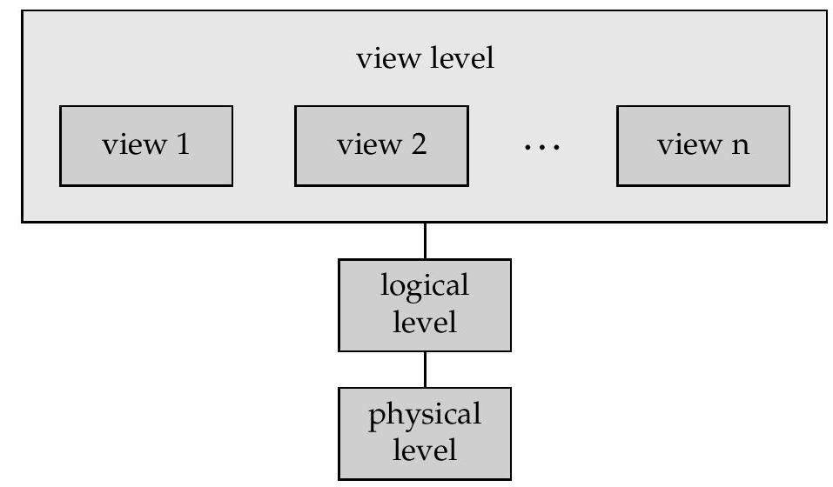
View of Data An architecture for a database system

Slide 14
Instances and Schemas
Schema – the overall structure of the database
e.g., the database consists of information about a set of customers and accounts and the relationship between them)
Three Types:
Physical/Internal schema: database design at the physical level
Logical schema: database design at the logical level
External Schema: Allows user interface at view level
Instance – the actual content of the database at a particular point in time

Slide 15
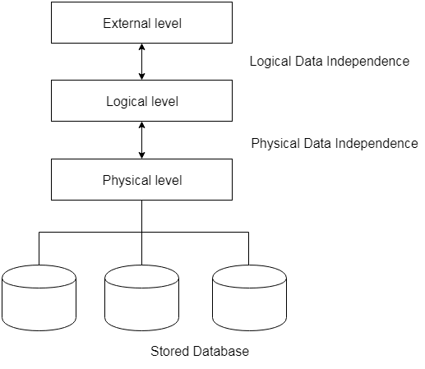
Data independence
Data Independence is defined as a property of DBMS that helps you to change the Database schema at one level of a database system without requiring to change the schema at the next higher level.
Data independence refers characteristic of being able to modify the schema at one level of the database system without altering the schema at the next higher level.
Data independence can be explained using the three-schema architecture.
External Schema
Conceptual Schema
Internal / Physical Schema

Slide 16
There are three types of data independence:
1.Logical data independence:
The ability to change the logical (conceptual) schema without changing the External schema (User View) is called logical data independence.
Logical data independence is used to separate the external level from the conceptual view.
If we do any changes in the conceptual view of the data, then the user view of the data would not be affected.
Logical data independence occurs at the user interface level.
For example, the addition or removal of new entities, attributes, or relationships to the conceptual schema or having to rewrite existing application programs.

Slide 17
There are three types of data independence:
2. Physical data independence:
The ability to change the physical schema without changing the logical schema is called physical data independence.
Physical data independence can be defined as the capacity to change the internal schema without having to change the conceptual schema.
If we do any changes in the storage size of the database system server, then the Conceptual structure of the database will not be affected.
Physical data independence is used to separate conceptual levels from the internal levels.
Physical data independence occurs at the logical interface level.
3. View level data independence: always independent no effect, because there doesn't exist any other level above view level.

Slide 18
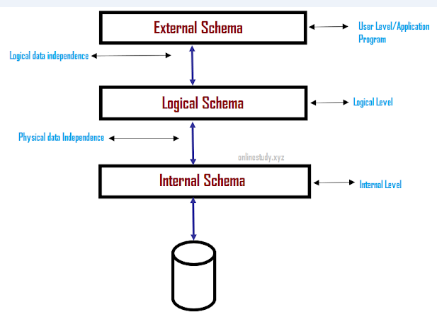

Slide 19
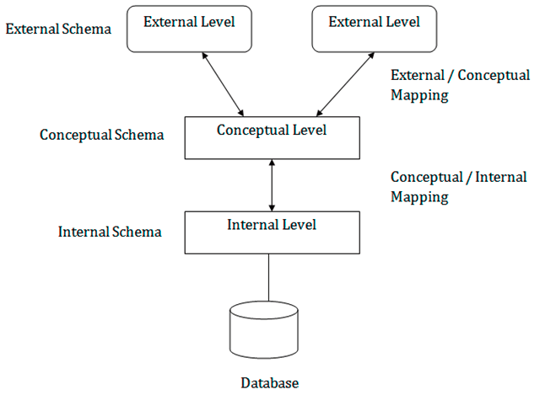
Three schema architecture
The three schema architecture is also called ANSI/SPARC architecture or three-level architecture.
This framework is used to describe the structure of a specific database system.
The three schema architecture is also used to separate the user applications and physical database.
The three schema architecture contains three-levels. It breaks the database down into three different categories.

Slide 20
In the given diagram:
It shows the DBMS architecture.
Mapping is used to transform the request and response between various database levels of architecture.
Mapping is not good for small DBMS because it takes more time.
In External / Conceptual mapping, it is necessary to transform the request from external level to conceptual schema.
In Conceptual / Internal mapping, DBMS transform the request from the conceptual to internal level.

Slide 21
The main objective of three level architecture is to enable multiple users to access the same data with a personalized view while storing the underlying data only once. Thus it separates the user's view from the physical structure of the database. This separation is desirable for the following reasons:
Different users need different views of the same data.
The approach in which a particular user needs to see the data may change over time.
The users of the database should not worry about the physical implementation and internal workings of the database such as data compression and encryption techniques, hashing, optimization of the internal structures etc.
All users should be able to access the same data according to their requirements.
DBA should be able to change the conceptual structure of the database without affecting the user's
Internal structure of the database should be unaffected by changes to physical aspects of the storage.

Slide 22
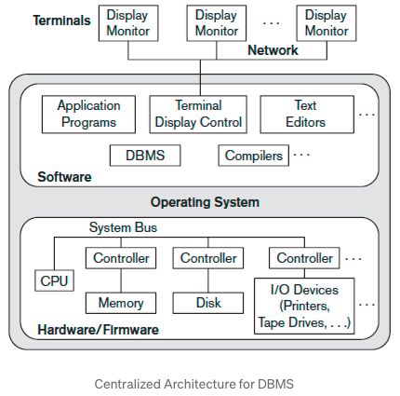
Centralized Architecture
In the centralized DBMS architecture, all the DBMS functionality, application program execution, and user interface processing are carried out on one central machine where user terminals are connected. Architectures for DBMSs have followed trends similar to those for general computer system architectures.
Earlier architectures used mainframe computers to provide the main processing for all system functions, including user application programs and user interface programs, as well as all the DBMS functionality. The reason was that most users accessed such systems via computer terminals that did not have processing power and only provided display capabilities. As prices of hardware declined, most users replaced their terminals with PCs and workstations. Gradually, DBMS systems started to exploit the available processing power at the user side, which led to client/server DBMS architectures.

Slide 23
Client-Server architecture
The concept of client/server architecture assumes an underlying framework that consists of many PCs as well as a smaller number of mainframe machines, connected via LANs and other types of computer networks.
A client in this framework is typically a user machine that provides user interface capabilities and local processing. When a client requires access to additional functionality, such as database access which does not exist at that machine, it connects to a server that provides the needed functionality.
A Server is a system which contains both Hardware and Software which provides services to client Machines like file access, printing and database access.

Slide 24
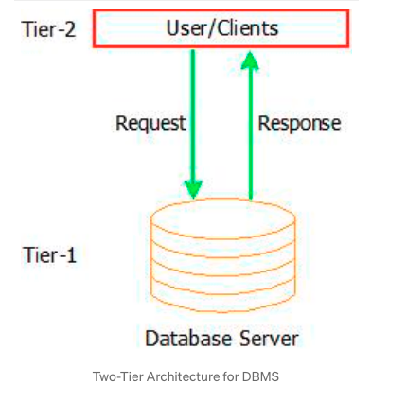
1)Two Tier Client/Server Architecture for DBMS:
Here Two-tier means that our Architecture has two layers, which are client layer and Data-layer. In Client layer we have several Client machines which can have the access to the database server. The API present on the client machine will establish the connection between the machine and the Database server through JDBC something else. This is because Clients and Database Server may be at different locations. Once this connection gets established, the Interface present on the client machine contains an Application Program on the back-side which contains a query. This query will be processed by the Database server and in turn the queried information will be sent to the client machine.
For example if we query the database to retrieve some information, the query will be Processed by Database server and that information will be sent to the client by Database server itself!!!

Slide 25
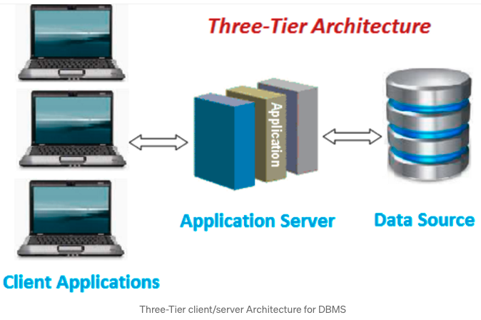
2) Three-Tier client/server Architecture for DBMS:
is an additional layer which acts as an intermediate between Client layer and Data layer called Business logic layer.
Business logic layer is the layer where the Application Programs are processed. Here the Application Programs are processed in the Application server itself, which makes it different from Two-tier Architecture where queries are processed in the database server.
Simply the Client machines will contact Application Server which in turn processes our Application Programs and fetches the Required Data from Database and then sends this Information back to the client machine in the suitable format only.

Slide 26
Even it is easy to maintain Two-Tier Architecture of DBMS it is still not scalable when we have large number of clients and also not secure because the clients are having direct access to database server.
But Three-Tier Architecture ensures Scalability and Security of the data because of the presence of this Intermediate layer which processes the queries and it just retrieves data from server instead of processing in the server to take place.

Slide 27
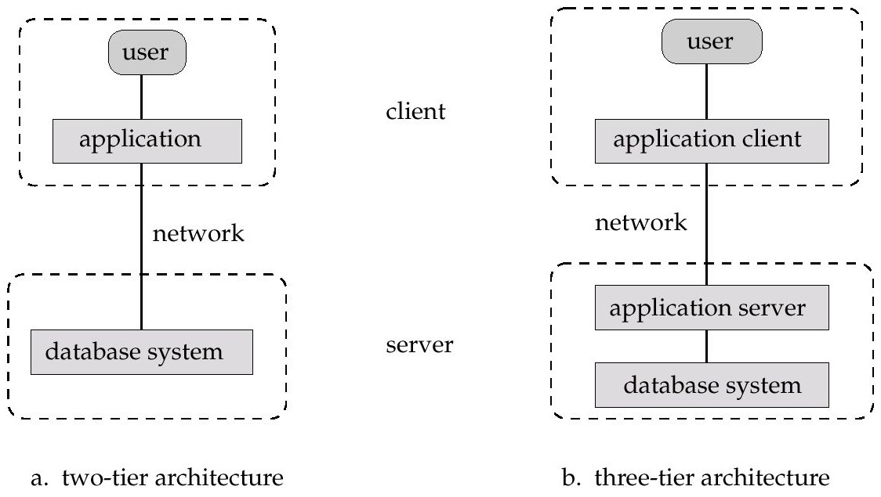
Two-tier architecture: E.g. client programs using ODBC/JDBC to communicate with a database
Three-tier architecture: E.g. web-based applications, and applications built using “middleware”

Slide 28
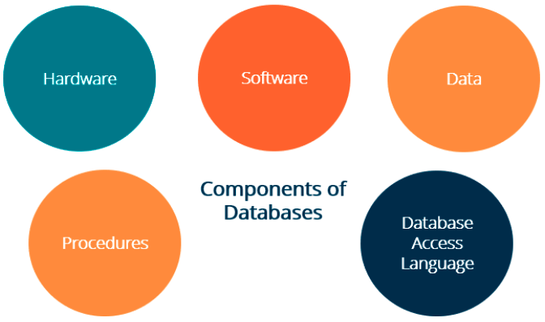
Database components

Slide 29
Hardware, Software, Data, Database Access Language, Procedures and Users all together form the components of a DBMS.
Hardware
The hardware is the actual computer system used for keeping and accessing the database. The conventional DBMS hardware consists of secondary storage devices such as hard disks. Databases run on the range of machines from micro computers to mainframes.
Software
Software is the actual DBMS between the physical database and the users of the system. All the requests from the user for accessing the database are handled by DBMS.
Data
It is an important component of the database management system. The main task of DBMS is to process the data. Databases are used to store the data, retrieved, and updated to and from the databases.

Slide 30
Users
There are a number of users who can access or retrieve the data on demand using the application and the interfaces provided by the DBMS.
The users of the database can be classified into different groups −
Native Users
Online Users
Sophisticated Users
Specialized Users
Application Users
DBA- Database Administrator

Slide 31
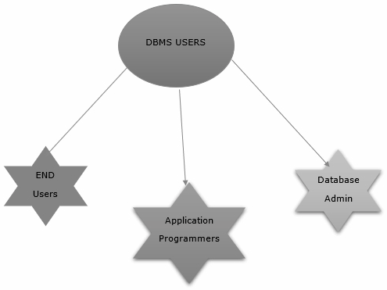
Database users
DBMS mainly classified into three users −
Database Administrator.
End Users.
Application Programmers.
The classification of users in DBMS is pictorially represented below −

Slide 32
Database users are categorized based up on their interaction with the database.
These are seven types of database users in DBMS.
A. Database Administrator (DBA) : Database Administrator (DBA) is a person/team who defines the schema and also controls the 3 levels of database. The DBA will then create a new account id and password for the user if he/she need to access the database. DBA is also responsible for providing security to the database and he allows only the authorized users to access/modify the data base. DBA is responsible for the problems such as security breaches and poor system response time.
DBA also monitors the recovery and backup and provide technical support.
The DBA has a DBA account in the DBMS which called a system or superuser account.
DBA repairs damage caused due to hardware and/or software failures.
DBA is the one having privileges to perform DCL (Data Control Language) operations such as GRANT and REVOKE, to allow/restrict a particular user from accessing the database.

Slide 33
B. Naive / Parametric End Users : Parametric End Users are the unsophisticated who don’t have any DBMS knowledge but they frequently use the database applications in their daily life to get the desired results. For examples, Railway’s ticket booking users are naive users. Clerks in any bank is a naive user because they don’t have any DBMS knowledge but they still use the database and perform their given task.
System Analyst : System Analyst is a user who analyzes the requirements of parametric end users. They check whether all the requirements of end users are satisfied.
Sophisticated Users : Sophisticated users can be engineers, scientists, business analyst, who are familiar with the database. They can develop their own database applications according to their requirement. They don’t write the program code but they interact the database by writing SQL queries directly through the query processor.

Slide 34
Database Designers : Data Base Designers are the users who design the structure of database which includes tables, indexes, views, triggers, stored procedures and constraints which are usually enforced before the database is created or populated with data. He/she controls what data must be stored and how the data items to be related. It is responsibility of Database Designers to understand the requirements of different user groups and then create a design which satisfies the need of all the user groups.
C. Application Programmers : Application Programmers also referred as System Analysts or simply Software Engineers, are the back-end programmers who writes the code for the application programs. They are the computer professionals. These programs could be written in Programming languages such as Visual Basic, Developer, C, FORTRAN, COBOL etc. Application programmers design, debug, test, and maintain set of programs called “canned transactions” for the Naive (parametric) users in order to interact with database.
Casual Users / Temporary Users : Casual Users are the users who occasionally use/access the database but each time when they access the database they require the new information, for example, Middle or higher level manager.

Slide 35
DBMS Languages
DDL – Data Definition Language
DML – Data Manipulation Language
DCL – Data control Language
TCL – Transaction control Language

Slide 36
SQL
Structured Query Language(SQL) as we all know is the database language by the use of which we can perform certain operations on the existing database and also we can use this language to create a database. SQL uses certain commands like Create, Drop, Insert, etc. to carry out the required tasks.
These SQL commands are mainly categorized into four categories as:
DDL – Data Definition Language
DQl – Data Query Language
DML – Data Manipulation Language
DCL – Data Control Language

Slide 37
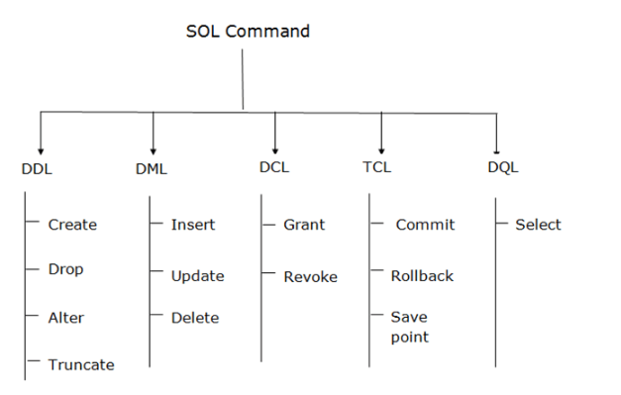

Slide 38
1.DDL (Data Definition Language):
DDL or Data Definition Language actually consists of the SQL commands that can be used to define the database schema. It simply deals with descriptions of the database schema and is used to create and modify the structure of database objects in the database.DDL is a set of SQL commands used to create, modify, and delete database structures but not data. These commands are normally not used by a general user, who should be accessing the database via an application.
List of DDL commands:
CREATE: This command is used to create the database or its objects (like table, index, function, views, store procedure, and triggers).
DROP: This command is used to delete objects from the database.
ALTER: This is used to alter the structure of the database.
TRUNCATE: This is used to remove all records from a table, including all spaces allocated for the records are removed.
RENAME: This is used to rename an object existing in the database.

Slide 39
Data Definition Language (DDL)
DDL changes the structure of the table like creating a table, deleting a table, altering a table, etc.
All the command of DDL are auto-committed that means it permanently save all the changes in the database.
Here are some commands that come under DDL:
CREATE
ALTER
DROP
TRUNCATE
a. CREATE It is used to create a new table in the database.
Syntax:
CREATE TABLE TABLE_NAME (COLUMN_NAME DATATYPES[,....]);
Example:
CREATE TABLE EMPLOYEE(Name VARCHAR2(20), Email VARCHAR2(100), DOB DATE);

Slide 40
b. DROP: It is used to delete both the structure and record stored in the table.
Syntax:DROP TABLE table_name;
Example:DROP TABLE EMPLOYEE;
c. ALTER: It is used to alter the structure of the database. This change could be either to modify the characteristics of an existing attribute or probably to add a new attribute.
Syntax:
To add a new column in the table
ALTER TABLE table_name ADD (column_name COLUMN-definition);
To modify existing column in the table:
ALTER TABLE table_name MODIFY(column_definitions....);
EXAMPLE
ALTER TABLE EMPLOYEE ADD(ADDRESS VARCHAR2(20));
ALTER TABLE EMPLOYEE MODIFY (NAME VARCHAR2(30));
d. TRUNCATE: It is used to delete all the rows from the table and free the space containing the table.
Syntax:TRUNCATE TABLE table_name;
Example:TRUNCATE TABLE EMPLOYEE;

Slide 41
2. DML(Data Manipulation Language):
The SQL commands that deals with the manipulation of data present in the database belong to DML or Data Manipulation Language and this includes most of the SQL statements. It is the component of the SQL statement that controls access to data and to the database. Basically, DCL statements are grouped with DML statements.
List of DML commands:
a.INSERT : It is used to insert data into a table.
b. UPDATE: It is used to update existing data within a table.
c. DELETE : It is used to delete records from a database table.
d. SELECT : It is used to retrieve records from database table.

Slide 42
INSERT: The INSERT statement is a SQL query. It is used to insert data into the row of a table.
Syntax:
INSERT INTO TABLE_NAME
(col1, col2, col3,.... col N)
VALUES (value1, value2, value3, .... valueN);
Or
INSERT INTO TABLE_NAME
VALUES (value1, value2, value3, .... valueN);
For example:
INSERT INTO EMPLOYEE(NAME, AGE,DOB,ADDRESS) VALUES ("Sonoo", 18,’11-02-2005’,”VIJAYAWADA”);
INSERT INTO EMPLOYEE VALUES ("Sonoo", 18,’11-02-2005’,”VIJAYAWADA”);

Slide 43
b. UPDATE: This command is used to update or modify the value of a column in the table.
Syntax:
UPDATE table_name SET [column_name1= value1,...column_nameN = valueN] [WHERE CONDITION]
For example:
UPDATE students
SET User_Name = 'Sonoo'
WHERE Student_Id = '3'
c. DELETE: It is used to remove one or more row from a table.
Syntax:
DELETE FROM table_name [WHERE condition];
For example:
DELETE FROM STUDENT
WHERE SID="Sonoo";

Slide 44
d. SELECT – It is called as DQL (Data Query Language):
DQL statements are used for performing queries on the data within schema objects. The purpose of the DQL Command is to get some schema relation based on the query passed to it. We can define DQL as follows it is a component of SQL statement that allows getting data from the database and imposing order upon it. It includes the SELECT statement. This command allows getting the data out of the database to perform operations with it. When a SELECT is fired against a table or tables the result is compiled into a further temporary table, which is displayed or perhaps received by the program i.e. a front-end.
List of DQL:
SELECT: It is used to retrieve data from the database.

Slide 45
SELECT: Data Query Language
DQL is used to fetch the data from the database.
It uses only one command:
SELECT
d.SELECT: This is the same as the projection operation of relational algebra. It is used to select the attribute based on the condition described by WHERE clause.
Syntax:
SELECT expressions FROM TABLES
WHERE conditions;
For example:
SELECT emp_name FROM employee
WHERE age > 20;
BCE239009@VITAPORCL
BCE239009\
DESC EMPLOYEE;
SELECT * FROM EMPLOYEE;

Slide 46
3.DCL (Data Control Language):
DCL includes commands such as GRANT and REVOKE which mainly deal with the rights, permissions, and other controls of the database system.
List of DCL commands:
GRANT: This command gives users access privileges to the database.
REVOKE: This command withdraws the user’s access privileges given by using the GRANT command.
a. Grant: It is used to give user access privileges to a database.
Example
GRANT SELECT, UPDATE ON MY_TABLE TO SOME_USER, ANOTHER_USER;
b. Revoke: It is used to take back permissions from the user.
Example
REVOKE SELECT, UPDATE ON MY_TABLE FROM USER1, USER2;

Slide 47
4.List of TCL commands:
a. Commit: Commit command is used to save all the transactions to the database.
Syntax:COMMIT;
Example:
DELETE FROM CUSTOMERS WHERE AGE = 25;
COMMIT;
b. Rollback: Rollback command is used to undo transactions that have not already been saved to the database.
Syntax:ROLLBACK;
Example:
DELETE FROM CUSTOMERS WHERE AGE = 25;
ROLLBACK;
c. SAVEPOINT: It is used to roll the transaction back to a certain point without rolling back the entire transaction.
Syntax:
SAVEPOINT SAVEPOINT_NAME;

